Slide 1


VECTOR
Adopted from MIT Course
FISIKA DASAR 1

Slide 2
What is Vector?
How do you describe a vector?
How do you add and subtract vectors?
Overview
2

Slide 3



What is Vector?
Introduction
Basic idea behind components
Exclusive Material
Bring your business to the next Level with Powerfull presentation material for all business
Want to do a quantitative calculation with vector
Need to convert multi-dimensional object to numbers, add or subtract or multiply the numbers, and then generate the multi-dimensional answer
Write each vector as a sum of smaller sub-vectors, all of which point in the same direction.
3
Notes:
Ukuran teks diperbesar

Slide 4
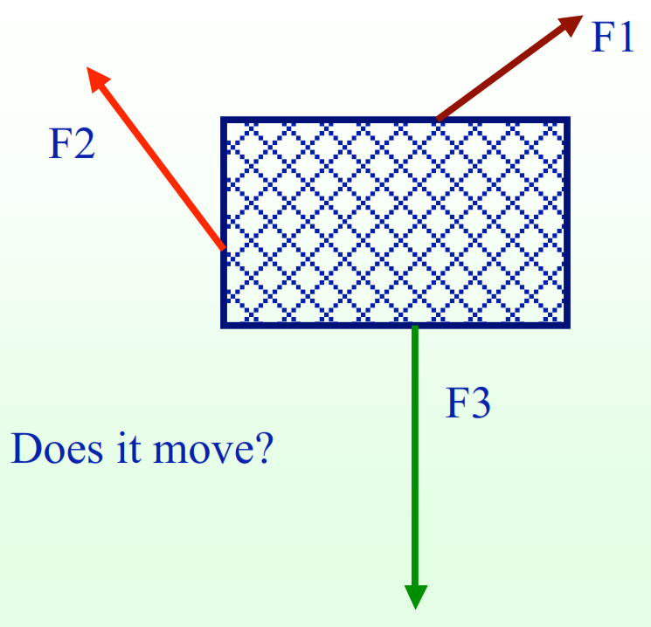
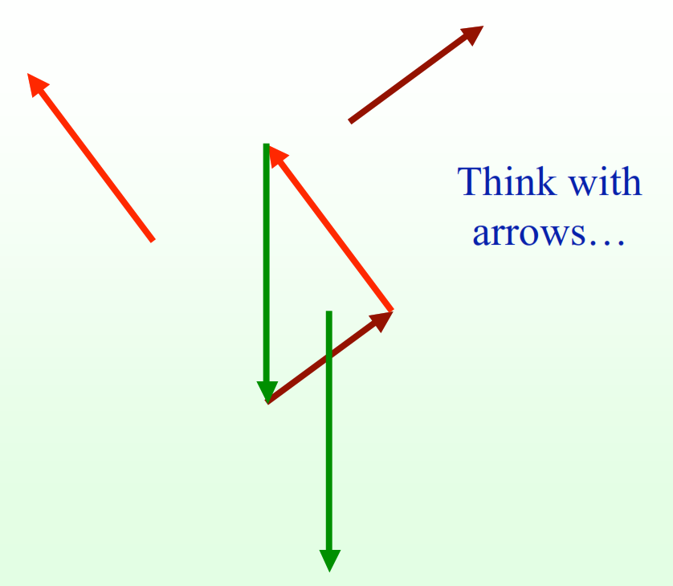
How do you describe a vector?
Vector
4

Slide 5
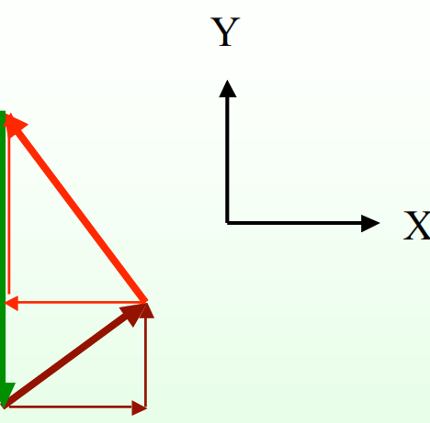
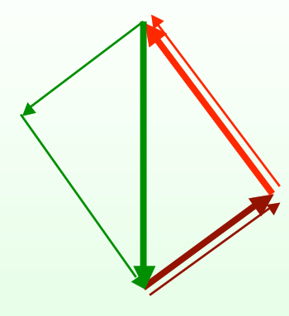
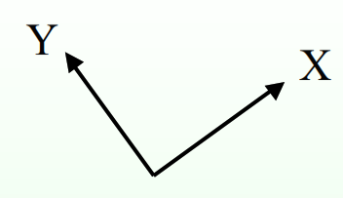
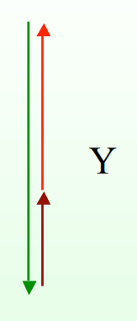
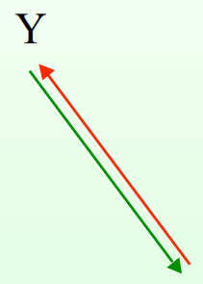
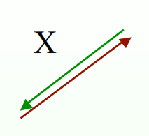

Vector
How do you add and subtract vectors?
Calculate with components - version 1
Calculate with components - version 2
5

Slide 6
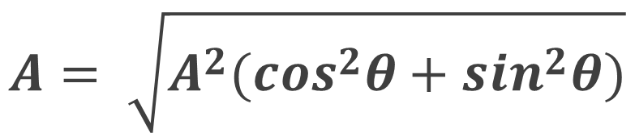
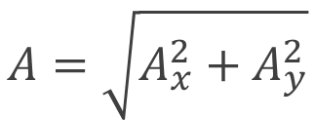






WORKING FOR COMPONENTS
Resultant
$$\overline{A} and θ are known. What A_{x} and A_{y} ?$$
$$y$$
$$A_{x}=A\cos{θ}$$
$$\overline{A}$$
$$A_{y}=A\sin{θ}$$
$$A=\sqrt{A_{x}^{2}+A_{y}^{2}}$$
$$θ$$
$$A= \sqrt{A^{2}{(cos}^{2}θ+\sin^{2}θ)}$$
$$x$$
6

Slide 7







Example 1
Example
A woman pulls a suitcase in 60 N force, forming a 40-degree angle to the horizontal. Determine the horizontal force and vertical force that occurs!
Solution:
$$y$$
$$F=60N$$
$$F_{x}=60 cos{40}^{o}=45,9N$$
$$F_{y}=60 sin{40}^{o}=38,6N$$
$${40}^{o}$$
$$x$$
7

Slide 8
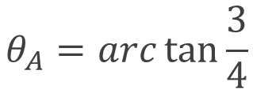












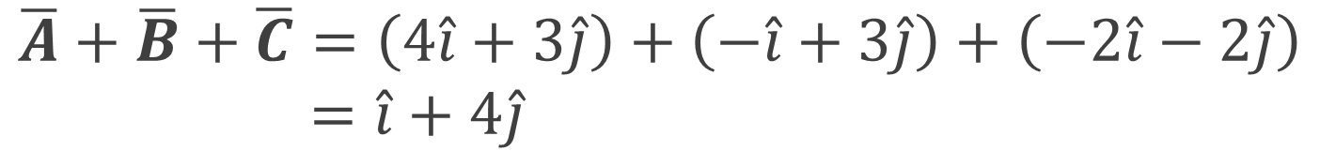

2D WORKING FOR RESULTANT
Resultant
$$y$$
$$\overline{A}+ \overline{B}$$
$$\overline{A}=4\hat{i}+3\hat{j}$$
$$\overline{B}=−\hat{i}+3\hat{j}$$
$$\overline{B}(−1,3)$$
$$\overline{A}(4,3)$$
$$\overline{A}+\overline{B}=3\hat{i}+6\hat{j}$$
$$\overline{A}−\overline{B}=5\hat{i}+0\hat{j}$$
$$θ_{A}$$
$$\overline{A}− \overline{B}$$
$$A=\sqrt{4^{2}+3^{2}}=5$$
Exclusive Material
$$x$$
$$θ_{A}=arc\tan{\frac{3}{4}}$$
$$\overline{B}\overline{c}(−2,−2)$$
$$\overline{A}+\overline{B}+\overline{C}=\left(4\hat{i}+3\hat{j}\right)+\left(−\hat{i}+3\hat{j}\right)+\left(−2\hat{i}−2\hat{j}\right)$$
$$=\hat{i}+4\hat{j}$$
8

Slide 9


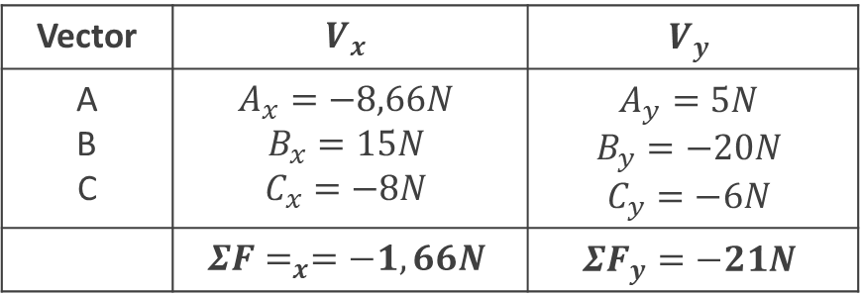
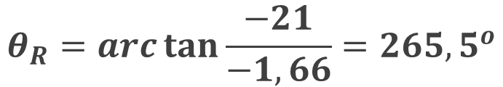




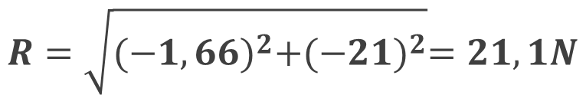









Example 2
Example
Solution:
Step 1
$$A_{x}=−10 cos{30}^{o}=−8.66N$$
$$A_{y}= 10 sin{30}^{o}=5N$$
$$B_{x}= 25 cos{53}^{o}=15N$$
$$B_{y}=−25 sin{53}^{o}=−20N$$
Calculate the resultant and specify the axis(x) positive direction!
$$C_{x}=−10 cos{37}^{o}=−8N$$
$$C_{y}=−10 sin{37}^{o}=−6N$$
$$y$$
Step 2
Vector | $$V_{x}$$ | $$V_{y}$$
A B C | $$A_{x}=−8,66N$$ $$B_{x}=15N$$ $$C_{x}=−8N$$ | $$A_{y}=5N$$ $$B_{y}=−20N$$ $$C_{y}=−6N$$
 | $${ΣF=}_{x}=−1,66N$$ | $${ΣF}_{y}=−21N$$
$$A=10N$$
$${30}^{o}$$
$${37}^{o}$$
$${53}^{o}$$
$$x$$
Step 3
$$\overline{R}=−1,66i −21j N$$
$$C=10N$$
$$R=\sqrt{{(−1,66)}^{2}+{(−21)}^{2}}=21,1N$$
$$θ_{R}=arc\tan{\frac{−21}{−1,66}={265,5}^{o}}$$
$$B=25N$$
9

Slide 10


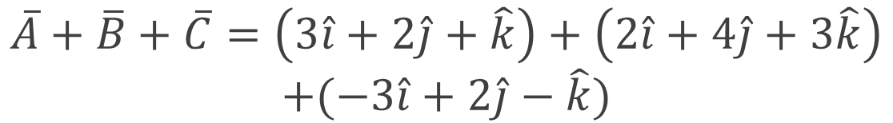



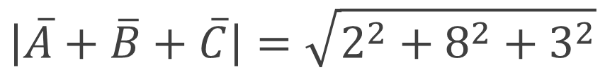





3D WORKING FOR RESULTANT
Resultant
$$y$$
$$\overline{A}+\overline{B}+\overline{C}=\left(3\hat{i}+2\hat{j}+\hat{k}\right)+\left(2\hat{i}+4\hat{j}+3\hat{k}\right)$$
$$+(−3\hat{i}+2\hat{j}−\hat{k})$$
$$\overline{B}(2,4,3)$$
$$\overline{C}(−3,2,−1)$$
$$\overline{A}+\overline{B}+\overline{C}=2\hat{i}+8\hat{j}+3\hat{k}$$
$$\overline{A}(3,2,1)$$
$$\hat{j}$$
$$\left|\overline{A}+\overline{B}+\overline{C}\right|=\sqrt{2^{2}+8^{2}+3^{2}}$$
Exclusive Material
Bring your business to the next Level with Powerfull presentation material for all business
$$\hat{i}$$
$$x$$
$$\hat{k}$$
$$z$$
10

Slide 11
SUMMARY
Vector: Any quantity characterized by both a magnitude and direction.’
Adding or subtracting vectors: Think with arrows, calculate with components.
Force is a Vector.
First criterion for static equilibrium is that the total force (added as vectors) is zero.
11

Slide 12
THANK YOU

